Slide 1
Factors affecting life expectancy
Rajkumar Cheney krishnan

Slide 2
objective
Identify factors that influence life expectancy in different countries.
For example, do the following factors impact life expectancy?
Immunization coverage
GDP levels
Population size
Government expenditure on healthcare (percentage)
Level of schooling
BMI
Alcohol consumption

Slide 3
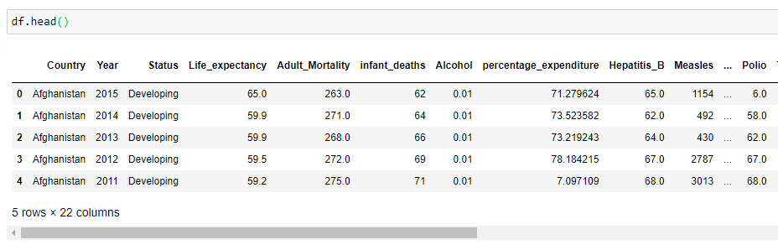
Data source
Data source: https://www.kaggle.com/kumarajarshi/life-expectancy-who
Combination of multiple datasets from WHO and UN on life expectancy, immunization levels, mortality data, economical factors and social factors

Slide 4
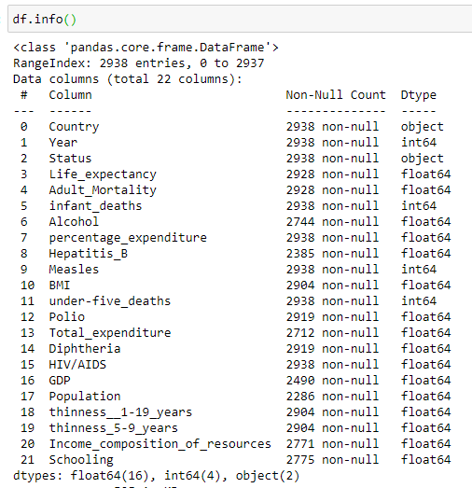
Exploratory data analysis
df.info()

Slide 5
Exploratory data analysis
Used Pandas to clean data
Renamed columns
Dropped columns not required
Converted columns to appropriate datatypes
Handled missing data
Filtered data

Slide 6
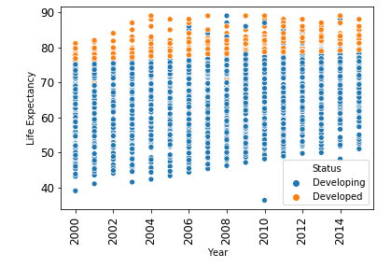
Exploratory data analysis
Used Seaborn package to create various visualizations
Life expectancy in developing countries improving, but still lagging developed countries

Slide 7
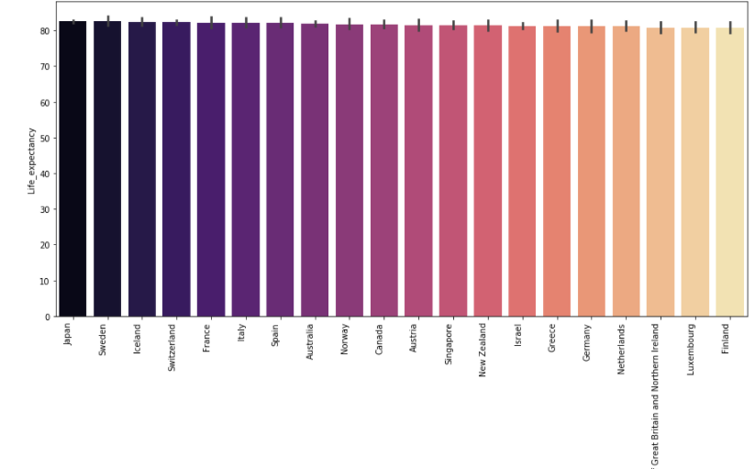
Exploratory data analysis
Top 20 countries in life expectancy

Slide 8
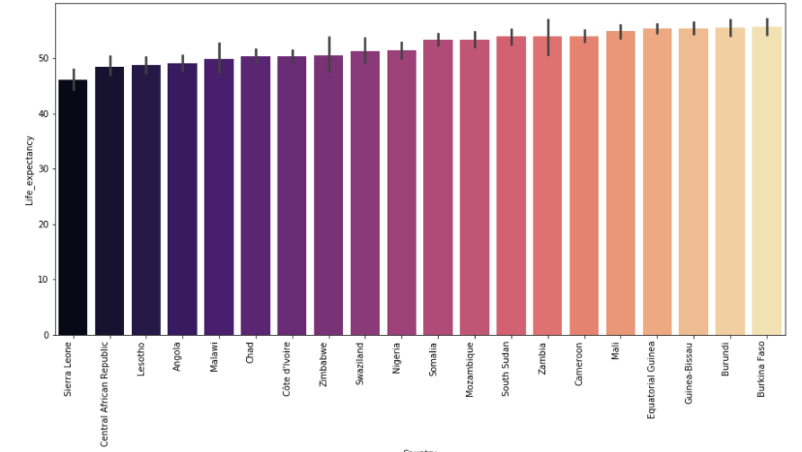
Exploratory data analysis
Bottom 20 countries in life expectancy

Slide 9
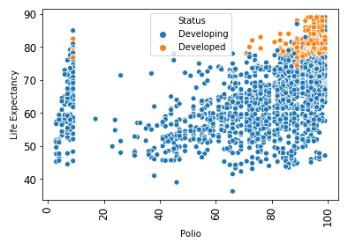
Exploratory data analysis
High polio vaccination rates are correlated with higher life expectancy.

Slide 10
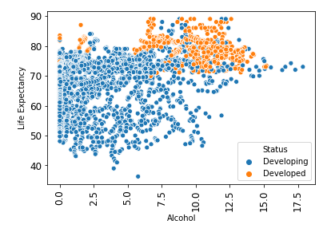
Exploratory data analysis
Drinking alcohol increases life expectancy???

Slide 11
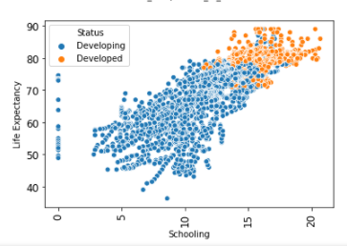
Exploratory data analysis
Years of schooling correlated with longer life expectancy?

Slide 12
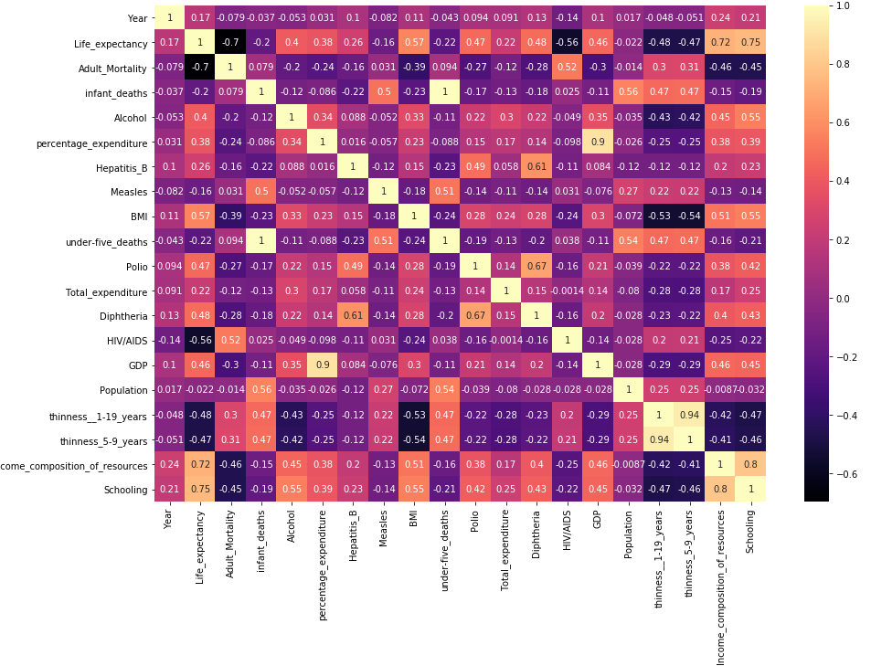
Exploratory data analysis
Heat map

Slide 13
THE END

